Slide 1
Name: KUBERAN S Reg.No: 711721243051 Department: AI&DS
Real time Image Animation using OpenCV
3/21/2024 Annual Review

Slide 2
PROJECT TITLE
Real time Image Animation using OpenCV and Deep Neural Network
3/21/2024 Annual Review

Slide 3


AGENDA
To develop a model to detect faces and recognize input images.
To identify real time face features from both Webcam and input images.
To integrate the face features to that of the input image.
Finally display the input image after swapping with the facial features of the real time video data.
3/21/2024 Annual Review

Slide 4

PROBLEM STATEMENT
The problem at hand is to develop a real-time image animation system leveraging OpenCV. The system aims to animate still images dynamically, replicating motion or altering features in a visually convincing manner. The primary challenge lies in creating an efficient and effective pipeline that can process images in real-time while maintaining high-quality animation output.
3/21/2024 Annual Review

Slide 5

PROJECT OVERVIEW
Real-Time Processing: The system must process images in real-time to ensure smooth animation playback without noticeable delays. This necessitates the implementation of efficient algorithms and optimizations to handle the computational workload within the constraints of real-time processing.
Feature Detection and Tracking: Accurately detecting and tracking features within the image, such as facial landmarks or object contours, is crucial for creating realistic animations. This involves implementing reliable feature detection and tracking mechanisms capable of handling variations in lighting, background, and object movement.
Animation Techniques: Various animation techniques, such as morphing or puppet animation, can be employed to bring images to life. Selecting and implementing the appropriate animation techniques requires a deep understanding of computer graphics principles and their application to image processing.
3/21/2024 Annual Review

Slide 6

WHO ARE THE END USERS?
Content Creators: Individuals or teams involved in content creation, including animators, filmmakers, and artists, could use the system to add dynamic elements to their projects, such as animated overlays, character animations, or special effects.
Educators: Teachers, instructors, and educational institutions might utilize the system for educational purposes, such as creating interactive learning materials, visualizing scientific concepts, or enhancing presentations with animated content.
Entertainment Industry Professionals: Professionals in the entertainment industry, including game developers, multimedia producers, and virtual reality content creators, could integrate the system into their workflows to enhance user experiences with immersive and interactive elements.
Advertisers and Marketers: Advertising agencies, marketing teams, and brands might employ the system to create engaging and attention-grabbing advertisements, promotional videos, or interactive marketing campaigns featuring animated content.
3/21/2024 Annual Review

Slide 7

YOUR SOLUTION AND ITS VALUE PROPOSITION
Real-Time Performance: By leveraging optimized algorithms and efficient resource utilization techniques, the solution ensures real-time processing of images, enabling smooth and responsive animation playback. This capability allows users to interact with the system seamlessly, without experiencing delays or lag.
High-Quality Animation: Through the implementation of robust feature detection, tracking, and animation techniques, the solution delivers high-quality animations that are realistic and visually appealing.
User-Friendly Interface: The solution includes an intuitive user interface that empowers users to customize animation parameters, select regions of interest, and control the animation process effortlessly. This user-friendly interface enhances the usability of the system, making it accessible to a wide range of users, including professionals and enthusiasts.
Cross-Platform Compatibility: With compatibility across various platforms and seamless integration with existing software environments, the solution offers flexibility and versatility in deployment. Users can deploy the system on different operating systems, hardware configurations, and development frameworks, ensuring widespread adoption and interoperability.
3/21/2024 Annual Review

Slide 8

THE WOW IN YOUR SOLUTION
Real-Time Magic: Imagine witnessing your images come to life before your eyes, with animations unfolding in real-time as you interact with the system. This instantaneous transformation from stillness to motion creates a sense of wonder and excitement, captivating users and immersing them in the creative process.
Cinematic Quality: Our solution doesn't just animate images; it elevates them to cinematic quality. Whether it's seamlessly morphing one image into another, puppeteering characters with fluid motion, or transferring facial expressions with astonishing realism, the animations produced are indistinguishable from scenes in a Hollywood movie.
Intuitive Control: With an intuitive user interface designed for simplicity and power, users can effortlessly customize every aspect of the animation process. From adjusting animation styles and intensities to selecting specific regions of interest within the image, users have full control over the creative direction, empowering them to unleash their imagination.
Anywhere, Anytime: Whether you're a professional animator on a film set, a teacher bringing lessons to life in the classroom, or a social media influencer creating captivating content on the go, our solution goes wherever creativity takes you.
3/21/2024 Annual Review
8

Slide 9
MODELLING
Feature Detection and Tracking Models:
Feature Point Detection Models: Algorithms like Scale-Invariant Feature Transform (SIFT), Speeded-Up Robust Features (SURF), or Oriented FAST and Rotated BRIEF (ORB) are used to detect distinctive features in images.
Animation Models:
Morphing Models: Linear or nonlinear interpolation techniques such as Thin Plate Spline (TPS) are used for morphing one image into another seamlessly.
Puppet Animation Models: Skeletal animation or mesh deformation models are utilized to animate characters or objects based on user-defined control points.
Facial Expression Transfer Models: Deep learning models like Generative Adversarial Networks (GANs) or Variational Autoencoders (VAEs)
User Interaction Models:
Graphical User Interface (GUI) Models: Model-View-Controller (MVC) or Model-View-ViewModel (MVVM) architectural patterns are commonly used to design intuitive user interfaces for controlling the animation process.
3/21/2024 Annual Review
9

Slide 10
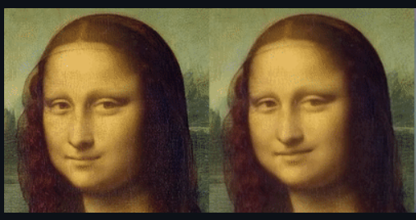
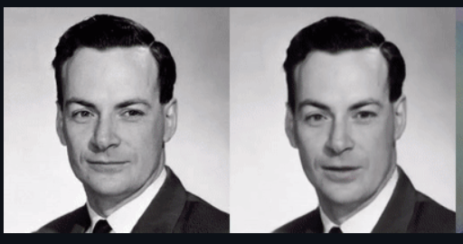
RESULTS
Demo Link
3/21/2024 Annual Review
10

